Slide 1
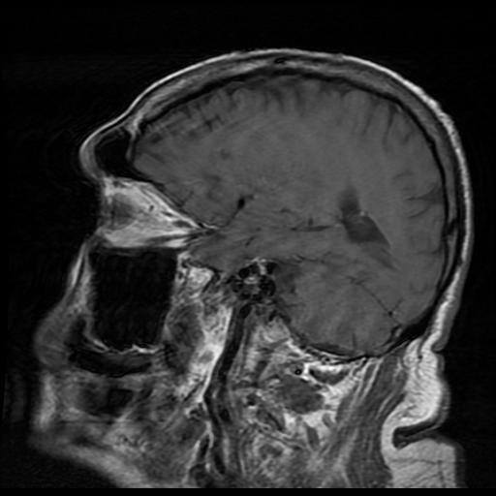

MEDICAL IMAGING
ENHANCEMENT
GROUP 3

Slide 2
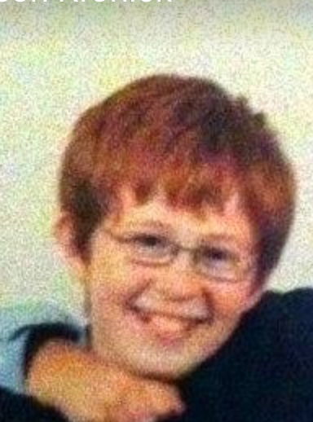
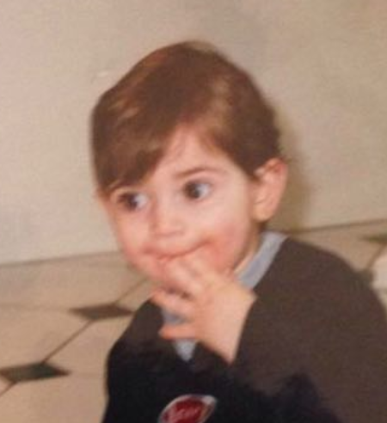
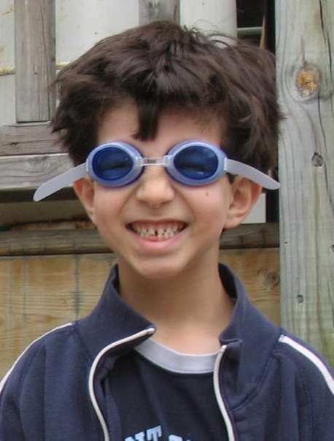
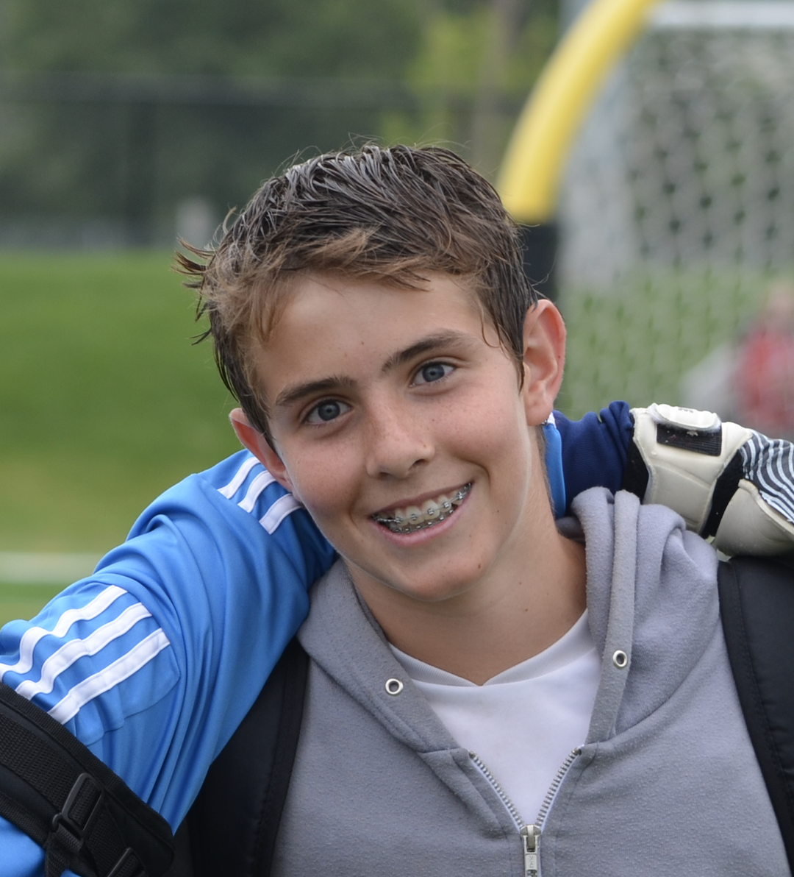
1
MEET OUR TEAM
JASON KRONICK
²⁰⁰²⁴⁰⁰⁵
ETHAN SHORE
²⁰⁰¹¹⁰⁴⁴
JACOB BEALLOR
²⁰⁰²⁰⁶¹³
ALEXANDRE LE BLANC
²⁰⁰⁰⁸¹³²
Notes:
Here’s our team members: Jason, jacob, Ethan and myself, alex.
Now lets get started!

Slide 3
2
INTRODUCTION
PROBLEM
Medical images can be blurry or unclear and hence difficult to examine.
Current high-quality medical imaging methods are expensive and slow.
“MRI machines are expensive – costing anywhere from $300,000 to a million dollars – which can strain a hospital’s budget.” ^{[1]}
- Corea, J. R. et al.
“CT is adequate for excluding brain metastases in most patients, but it can miss low-grade tumours or small lesions.” ^{[2]}
- Shonka, N. A. et al.
Notes:
PROBLEM:
- Finding signs of disease in medical images - for example: X-rays, CT scans and MRI’s - can be very difficult due to unclear images.
This is especially true during early stages when markers are small, few, and get easily lost within the images due to lack in image quality.
- Additionally, to obtain high resolution medical images, the equipment and methods are very costly. A single MRI scanner can cost anywhere between $300,000 to $1 million dollars.
_________________________________________________
“CT is adequate for excluding brain metastases in most patients, but it can miss low-grade tumors or small lesions located in the posterior fossa.”
- Shonka et al.
https://www.cancernetwork.com/cancer-management/primary-and-metastatic-brain-tumors/page/0/1?fbclid=IwAR36gZydOT-rJXAZL-TavOdrhX4Gw1Sdfemmq8GAR9mRed3RtLjilx4fL0c
“Early detection is a top priority since it often increases the chances that a cancer will be successfully treated.”
- Dr Shana Kelley, a professor and researcher at the University of Toronto,
https://www.cancer.ca/en/about-us/our-research/making-an-impact----cancer-research/fighting-for-life-4-on/?region=on
“Unfortunately MRI data acquisition is inherently slow and signal-to-noise ratio (SNR) starved. This limits the spatial resolution, diagnostic image quality and typically results in long acquisition times that are prone to motion artefacts.”
- Corea et al.
https://www.nature.com/articles/ncomms10839?fbclid=IwAR34j7nlq-MV_pvpPNxz9_lSzuhEqwccaw80y-KAUFS2V8VV2A0WZjkvNqs
“MRI scans take so long because they have a very low sensitivity. In some challenging pediatric cases where the patient is moving, the images may be degraded with artifacts—leading to useless data that can get in the way of a clear picture. ”
“MRI machines are expensive –costing anywhere from $300,000 to a million dollars—which can strain a hospital’s budget.”
- Corea, J. R. et al.
https://www.nibib.nih.gov/news-events/newsroom/new-mri-coils-aim-improve-patient-comfort-and-decrease-scan-time?fbclid=IwAR34j7nlq-MV_pvpPNxz9_lSzuhEqwccaw80y-KAUFS2V8VV2A0WZjkvNqs

Slide 4
3
INTRODUCTION
“39.3% of the US population will be diagnosed with cancer at some point during their lifetime.” ^{[3]}
- National Cancer Institute
MOTIVATION
Everyone is at risk of cancer and other disease.
Due to high costs, medical imaging and diagnosis is not accessible to everyone.
Low-quality images or blurriness may lead to inaccurate or inconclusive diagnosis.
OBJECTIVE
To enhance the resolution of medical images using machine learning techniques and, in doing so, provide a possible method of improving the accuracy and reducing the costs involved with medical imaging and analysis.
Notes:
MOTIVATION:
Reducing the costs of medical imaging is of utmost importance because currently not everyone can afford the costs of medical imaging and treatment, but everyone is at risk of contracting a disease such as cancer.
Additionally, Improving the accuracy of medical image analysis is crucial because if a tumour goes unperceived, it may lead to untreated disease, and potentially death.
OBJECTIVE:
Therefore, for our project, our group’s goal was to enhance the resolution of medical images using machine learning techniques and, in doing so, provide a possible method of reducing the difficulty and costs involved with medical imaging and analysis.
_________________________________________________
“CT is adequate for excluding brain metastases in most patients, but it can miss low-grade tumors or small lesions located in the posterior fossa.”
- Shonka et al.
https://www.cancernetwork.com/cancer-management/primary-and-metastatic-brain-tumors/page/0/1?fbclid=IwAR36gZydOT-rJXAZL-TavOdrhX4Gw1Sdfemmq8GAR9mRed3RtLjilx4fL0c
“Early detection is a top priority since it often increases the chances that a cancer will be successfully treated.”
- Dr Shana Kelley, a professor and researcher at the University of Toronto,
https://www.cancer.ca/en/about-us/our-research/making-an-impact----cancer-research/fighting-for-life-4-on/?region=on
“Unfortunately MRI data acquisition is inherently slow and signal-to-noise ratio (SNR) starved. This limits the spatial resolution, diagnostic image quality and typically results in long acquisition times that are prone to motion artefacts.”
- Corea et al.
https://www.nature.com/articles/ncomms10839?fbclid=IwAR34j7nlq-MV_pvpPNxz9_lSzuhEqwccaw80y-KAUFS2V8VV2A0WZjkvNqs
“MRI scans take so long because they have a very low sensitivity. In some challenging pediatric cases where the patient is moving, the images may be degraded with artifacts—leading to useless data that can get in the way of a clear picture. ”
“MRI machines are expensive –costing anywhere from $300,000 to a million dollars—which can strain a hospital’s budget.”
- Corea, J. R. et al.
https://www.nibib.nih.gov/news-events/newsroom/new-mri-coils-aim-improve-patient-comfort-and-decrease-scan-time?fbclid=IwAR34j7nlq-MV_pvpPNxz9_lSzuhEqwccaw80y-KAUFS2V8VV2A0WZjkvNqs

Slide 5
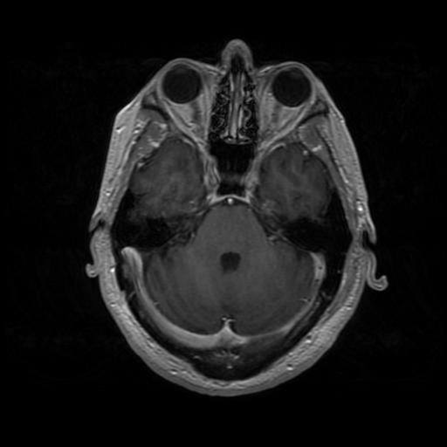

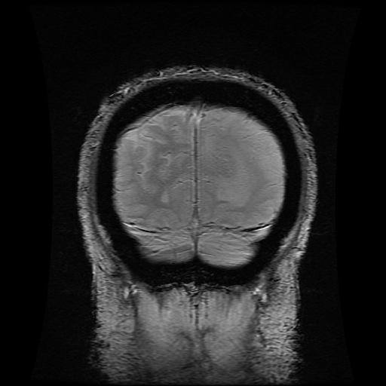
4
DATASET
Dataset from the Cancer Imaging Archive^{[4]}
Images of National Cancer Institutes’ CPTAC-GBM patients.
GBM: Glioblastoma Multiforme, a fast-growing brain tumour.
156,493 images (39.8 GB).
Image resolution: 256x256 to 512x512.
66 patients.
Various modalities: CR, CT, MRI, and SC.
Dataset updated on 02/14/2020.
Notes:
For our experiments, we used the CPTAC-GBM image dataset made publicly available by the Cancer Imaging Archive
The dataset includes radiology brain images from cancer patients with Glioblastoma Multiforme, which is a fast-growing brain tumour.
There were 156,943 images available, with varying resolutions, obtained through various medical imaging techniques.

Slide 6
5
1
Collected
24,000 Images
From Dataset
3
Filtered Out Undetailed Images
Selected Images Of Size 512 x 512
Final Dataset of 5,000 Images
2
4
DATA PREPROCESSING
Notes:
Dataset was huge so downloaded around 24000 images
Converted images to jpg so that they would be easier t
Selected images that were 512 x 512 we wanted to use a scaling factor of 4 like the paper but were limited by compute power.
Wanted images that had enough detail so that they would be interested to increase the resolution
Given that the size of the database was 156000 images, we only downloaded a subset of 24,000 images
Are goal was to increase resolution by a factor of 4 as was done in the SRGAN paper so we needed to choose images that were big enough to for the upscaling to be noticeable. However, as we had limited computing power we could not choose an image size that was too large as this would increase model complexity. We decided to only use images of size 512 x 512 pixels as these were large enough for noticeable scaling but not too large to make compute time unrealistic.
Looking through the 512 x 512 images we noticed many images that were mostly black and contained objects that were monochromatic with not a lot of detail. An increase in resolution of these types of images would not be very noticeable and would not be ideal for evaluation. Therefore, we applied a filtration technique to remove these undetailed images from the dataset. This technique is described on the next slide.
After all preprocessing was applied, our final dataset contained roughly 5,000 images

Slide 7
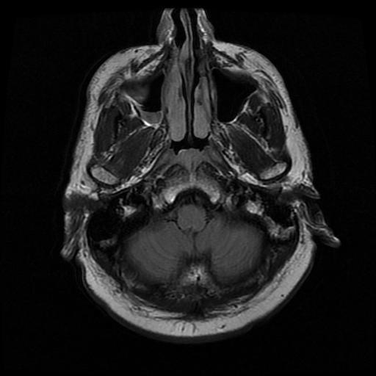

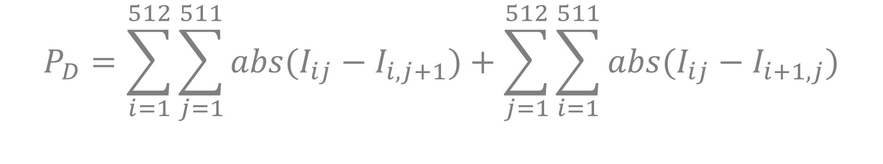
6
FILTERING
(
)
abs
0.9
0.2
Calculate adjacent pixel differences
$$P_{D}=\sum_{i=1}^{512}{\sum_{j=1}^{511}{{abs(I}_{ij}−I_{i,j+1}}})+\sum_{j=1}^{512}{\sum_{i=1}^{511}{{abs(I}_{ij}−I_{i+1, j}}})$$
Where,
$$I_{ij} = value of pixel at i^{th} row j^{th} column$$
$$P_{D} = overall pixel difference$$
More detailed images have higher $P_{D}$ value
Apply Gaussian filter before to account for noisy images
Notes:
To filter out undetailed images we first needed a way to quantify the level of detail of an image
We did this by calculating the overall adjacent pixel difference of each image. The overall adjacent pixel difference was calculated by summing the difference in adjacent pixels in every row and and in every column. The motivation behind this method is that less detailed images would have long strings of pixels of similar value yielding low overall differences in adjacent pixels whereas detailed images would contain many more occurrences of pixels of much different values beside one another yielding a higher overall adjacent pixel difference.
However, a problem realized in this method was that noisy images would be given the highest scores as they would contain many adjacent pixels with highly different values. To account for this, we first applied a Gaussian filter to smooth out noisy areas of images before the overall pixel difference was calculated

Slide 8
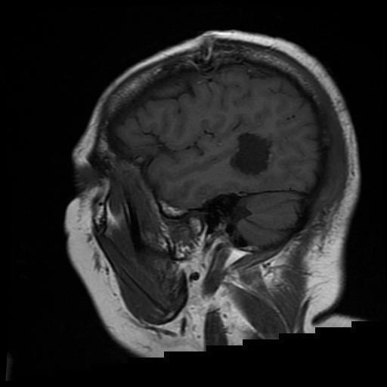
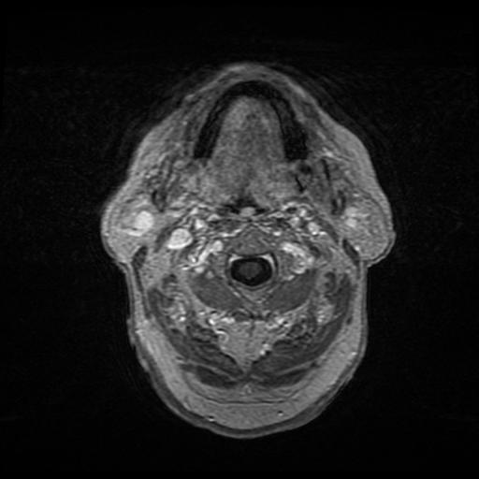
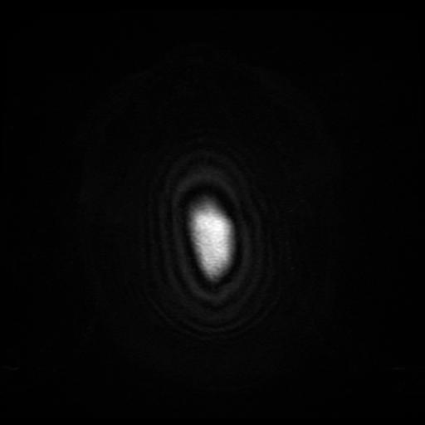
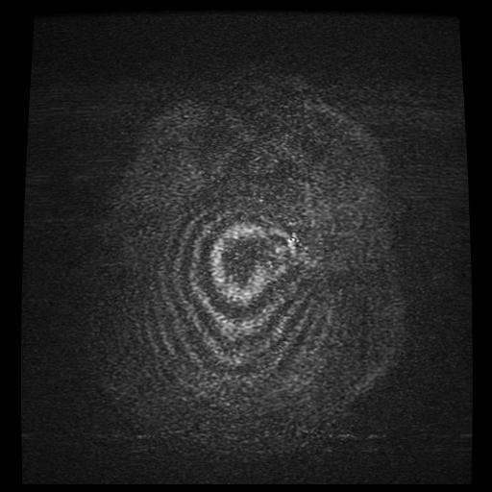
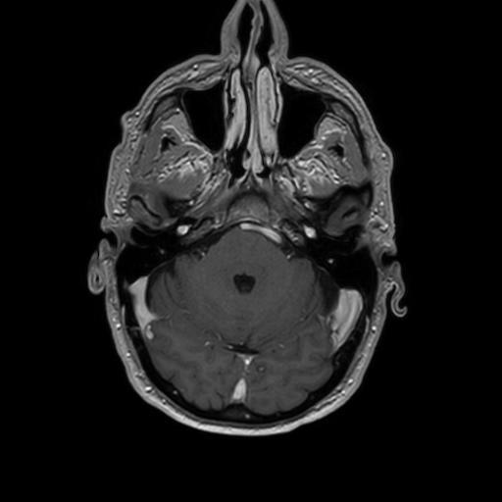
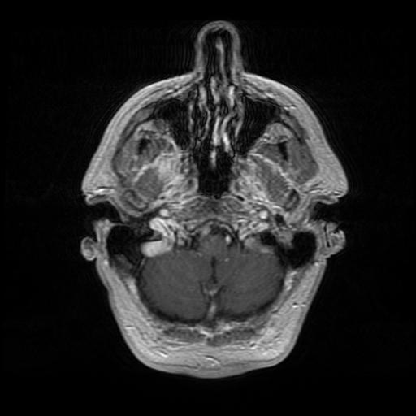
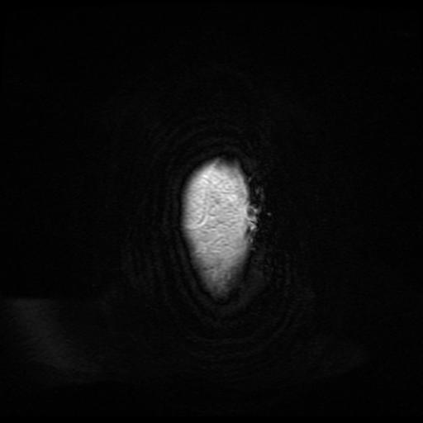
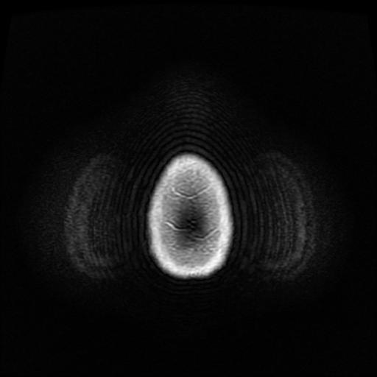
7
FILTERING
Implementation: Discard images with lower than average $P_{D}$ value
K E P T
D I S C A R D E D
Notes:
To implement this method to filter out unwanted images, we calculated the Pd value of every image and then discarded images with lower than average Pd value.
Shown here are some of the images that were kept and some that were discarded

Slide 9
8
MODEL SELECTION
INTERPOLATION METHODS
Baseline approach
Three different algorithms:
Nearest neighbor
Bilinear interpolation
Bicubic interpolation
SR-RESNET & SRGAN
Deep learning based approach
SR-RESNET uses a supervised approach
SRGAN fine tunes using adversarial training
Notes:
Once we downloaded and preprocessed the dataset, it was time to look at different models we could use to achieve our goal.
The first approach is use interpolation methods, which are quick and easy, and can act as a baseline measure. We selected three interpolation algorithms, those being nearest neighbour, bilinear, and bicubic interpolation.
For a more sophisticated approach, we chose to investigate using SR-ResNet and SRGAN.
The SR-ResNet is a deep learning based approach that trains a model using supervised learning, while the SRGAN builds off of this by further fine tuning the SR-ResNet using adversarial training.

Slide 10




9
TECHNICAL NEEDS
Used TensorFlow and Keras to build and train deep learning models
Due to the complexity of the SRGAN, set up virtual machines using Google Cloud Platform to gain access to GPUs and more compute power
Notes:
On the technical side we used python as a base language and used a combination of Keras and TensorFlow to build and train our deep learning models.
Due to the complexity of the SR-ResNet and SRGAN, we resorted to using cloud computing by using Google cloud platform to set up virtual machines, which gave us access to GPUs and greater compute power.

Slide 11
10
EVALUATION METRICS
PSNR
SSIM
MOS
PEAK SIGNAL-TO-NOISE RATIO
Estimates absolute error
between two images.
Range: [0, ∞)
STRUCTURAL SIMILARITY INDEX
Indication of perceived
similarities between two
images.
Range: [0, 1]
MEAN OPINION
SCORE
Quantify image quality
using a human-judgement
scoring system.
Range: [1, 5]
Notes:
To evaluate the experiments and corresponding outputs, we used three commonly-used metrics:
- The Peak Signal-to-Noise Ratio;
- Structural Similarity index and;
- Mean-Opinion-Score.
PSNR represents the absolute pixel-wise errors between a reference image and test image. The scores range from zero to infinity. The higher the score, the less difference in the test image.
SSIM measures the similarity between two images. It is a better indication of perceived changes between two images, taking into account more factors such as loss of correlation, luminance distortion and contrast distortion. Scores range between 0 and 1, 0 being worst, 1 being the best or identical.
While PSNR and SSIM are both computationally calculated with code, MOS is obtained through a human survey and is a direct representation of an image’s quality perceived by the human eye. Scores range between 1 and 5, where 1 is a poor quality image and 5 is a high quality image.
__________________________________________________
To obtain the mean opinion score, survey participants are shown different versions of an image - each of which has undergone a different super-resolution method - along with the original image. The participants are asked to rate the images on a scale of 1-to-5, where 1 is a poor quality image and 5 is a high quality image. This is repeated with various images. For each image, the average survey score for each super-resolution method is calculated. Then the overall average for each super-resolution method is computed to give a final MOS score for each method.

Slide 12
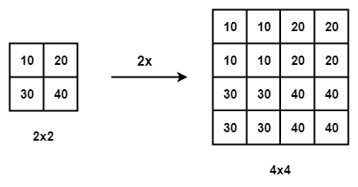

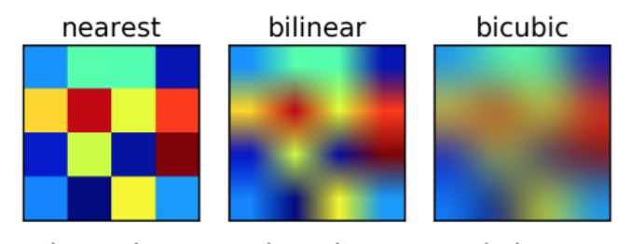
INTERPOLATION METHODS
11
Nearest-Neighbour
Bilinear
Bicubic
Replicates the colour value of the nearest pixel
Simplest and quickest, but least effective method
Uses linear interpolation in both directions (4 pixels)
Results in smoother images
Takes longer but is more effective than nearest-neighbour.
Uses cubic interpolation in both directions (16 pixels)
Results in smoothest images of all the methods
Takes the longest but is most effective

Slide 13
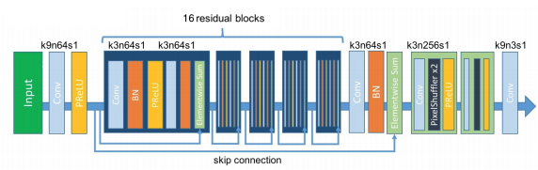
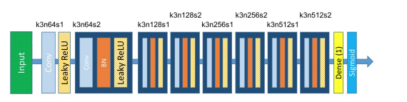
12
SRGAN ARCHITECTURE
Generator
Image
Discriminator
(0,1)
Notes:
As with all generative adversarial networks, the SRGAN includes a generator network and discriminator network.
Following the SRGAN paper, the generator network is comprised of a convolutional layer with prelu activation layer, followed by 16 resnet blocks with a skip connection from the input of the first block to the output of the last block. Then we have a combination of convolution and pixel shuffle layers to obtain a super resolution output image
The discriminator network is made of 8 convolutional layers with leakyrelu activation followed by a dense layer with 1 output and finally a sigmoid activation layer to obtain the desired 0 to 1 output

Slide 14
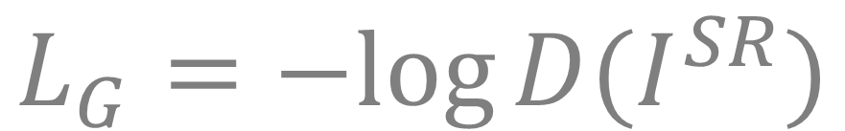
13
SRGAN ADVERSARIAL LOSS
Discriminator
$$L_{D}=−log{D(I^{R})}−log{(1− D\left(I^{SR}\right))}$$
Generator
$$L_{G}=−log{D(I^{SR})}$$
Where,
$$D\left(I\right)=output of discriminator given image I$$
$$I^{R}, I^{SR}=real and generated images respectively$$
Notes:
As the discriminator’s goal is to be able to distinguish between real and generated images, the discriminator loss is calculated by taking the log of of its output with a real image input and the log of 1 minus its output with a generated image input.
If the discriminator outputs values close to zero given real images the negative log of the output will be high, yielding greater loss but if its output is closer to one then the loss is decreased. Similarly, if the discriminator outputs values close to 1 for generated images, negative the log of 1 minus the output will be high yielding greater loss while outputs close to 0 for generated images will decrease the loss.
Therefore, the discriminator aims to minimize the loss by labelling real images with value 1 and generated images with value 0
The generator on the other hand aims to trick the discriminator into labelling the data it generates as real therefore its loss for a generated image is negate the log of the discriminators output. If the discriminator outputs values close to one for generated images the loss will be low whereas discriminator out.puts close to 0 cause high generator loss

Slide 15
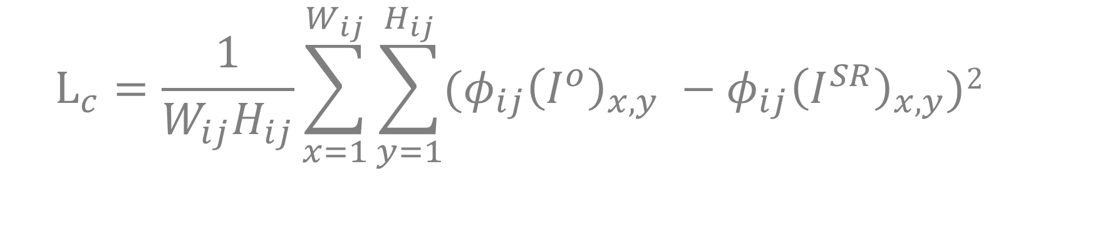
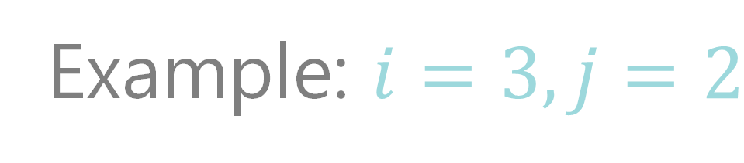
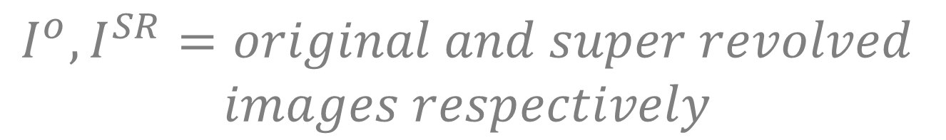
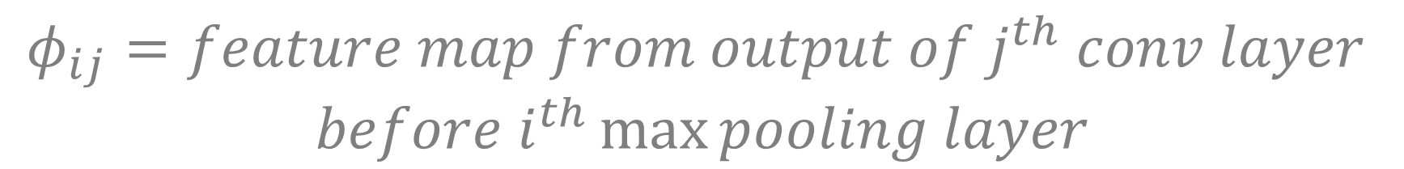
14
SRGAN CONTENT LOSS
Use pretrained VGG19 network to obtain feature map
Loss is MSE of original and super resolution image features
$$L_{c}=\frac{1}{W_{ij}H_{ij}}\sum_{x=1}^{W_{ij}}{\sum_{y=1}^{H_{ij}}{{(φ}_{ij}{\left(I^{o}\right)}_{x,y} −φ_{ij}{\left(I^{SR}\right)}_{x,y}})2 }$$
Example: $i=3, j=2$
Where,
$$φ_{ij}=feature map from output of j^{th} conv layer$$
$$before i^{th}\max{pooling layer}$$
$$W_{ij}{, H}_{ij}=width and height of repective feature map$$
$$I^{o}, I^{SR}=original and super revolved$$
$$images respectively$$
Take output of this layer
Notes:
The second type of loss implemented in the SRGAN is a content loss. To calculate the content loss a pretrained VGG19 network is utilized to obtain a feature map.
The feature map used for the loss can be obtained from the ouptut of any convolutionl layer of the network. The layer chosen for the feature map is described by i and j where the layer is the jth convolutional layer before the ith max poiling layer in the network.
The loss is defined as the mse between the output feature map obtained by inputting the original image into the VGG19 network and the output feature map obtained given the super resolution version of that image as input.
the equation for loss is shown here were phi i j is the feature map from the ouput of the jth conv layer before the i max pooling layer, Wij Hij is the width and height of the feature map
and I not and I sr are the original and super revolved images respectively
to better explain how the feature map is obtained lets use an example wehre i =3 and j = 2
count 1 2 3 max pooling layers and take the output of the second conv layer before the max pooling layer as the feature map

Slide 16


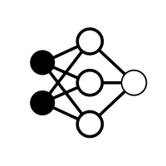

15
Split high resolution image dataset into training, validation and test sets of with 1000, 200, and 200 images, respectively.
Downsample images by factor of four to use a inputs for the model
TRAINING PROCEDURE
Train generator in a supervised manner using MSE loss for 100 epochs
Train generator for additional 50 epochs using GAN architecture, adversarial loss and VGG content loss
Notes:
To train our models, we first loaded in the high resolution images and split them into training, validation and test sets with 1000, 200, and 200 images, respectively.
Next we downsampled these images to obtain the low resolution images to use as inputs to our models.
We then trained the SR-ResNet using mean squared error loss for 100 epochs in a supervised approach, after which we used the GAN architecture, adversarial loss, and content loss to train the generator for an additional 50 epochs.

Slide 17
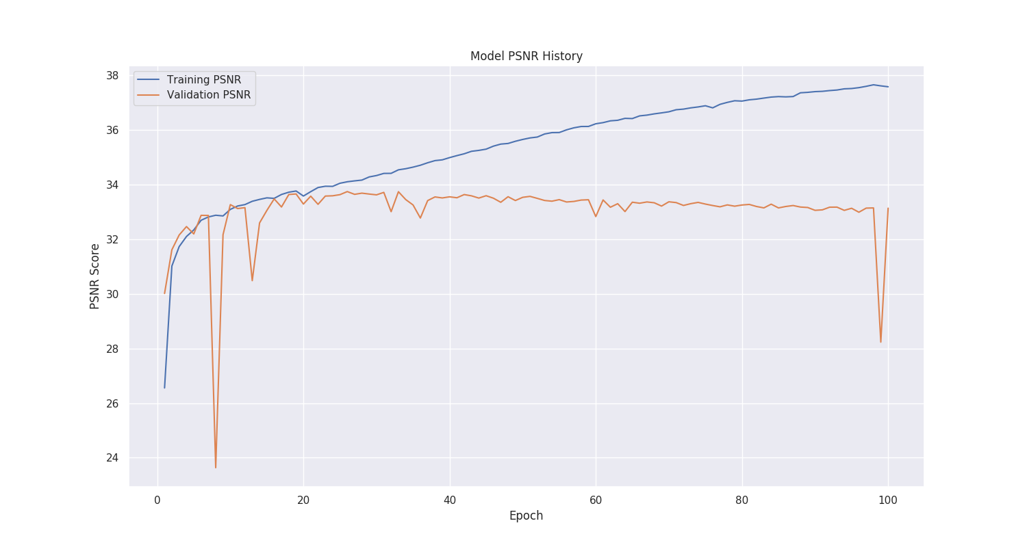
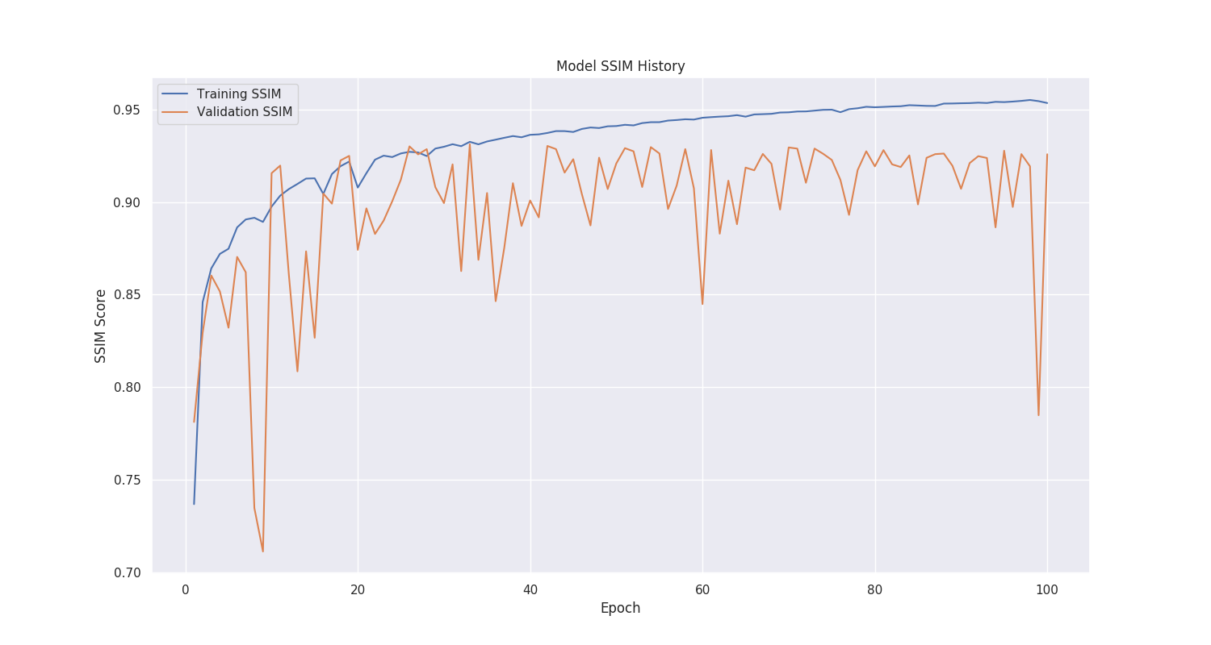
16
TRAINING RESULTS
PSNR and SSIM scores continue to increase on training data.
Model performs more poorly on validation data, indicating possible overfitting
Notes:
As you can from the training history of the SR-ResNet, the SSIM and PSNR scores continuously increase on the training data, however the models starts to perform more poorly on the validation data. While the validation scores are still high, this indicates that the model is most likely overfitting the training data.

Slide 18
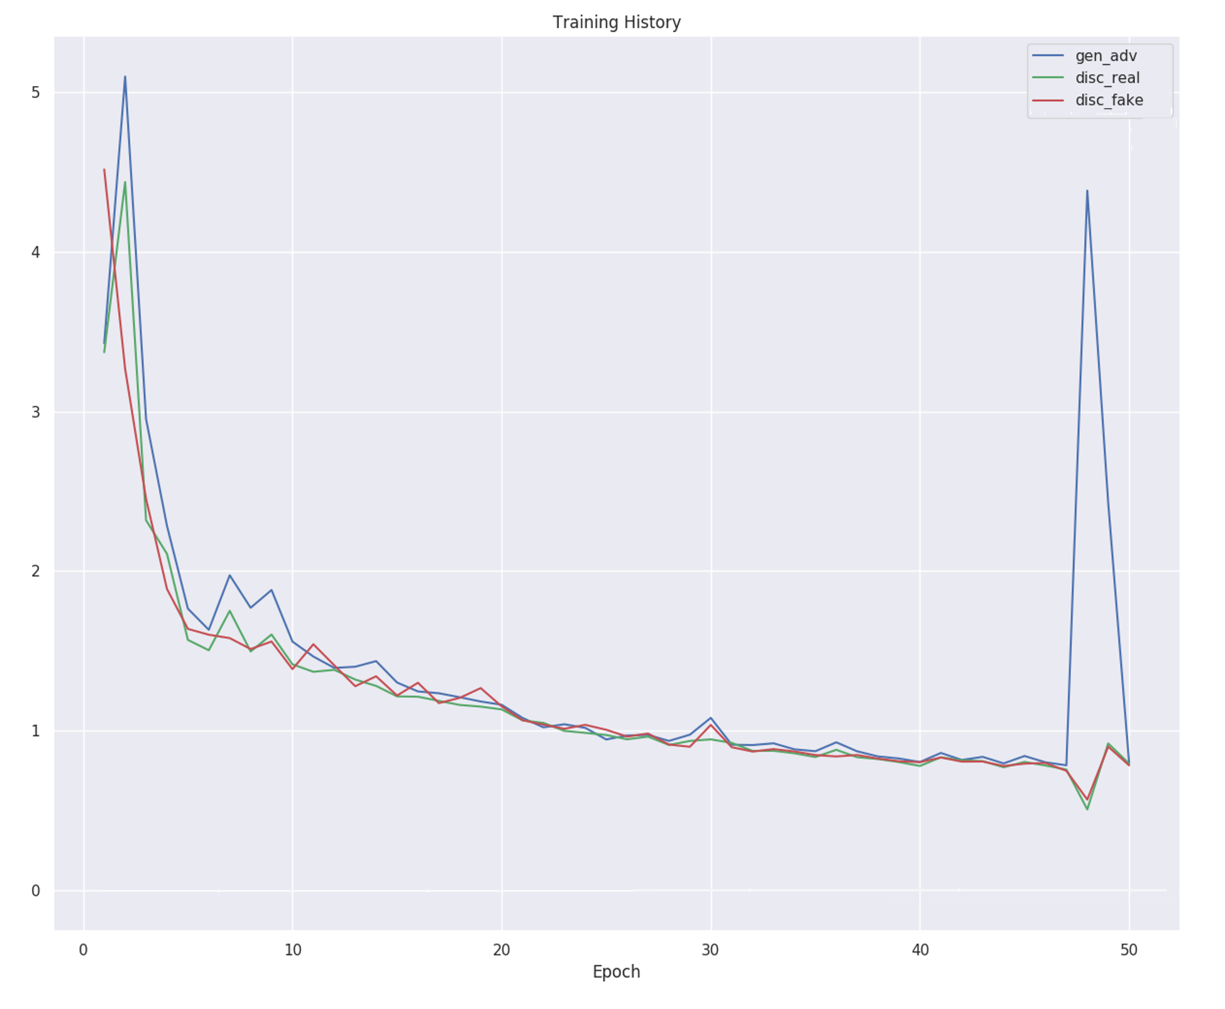
17
TRAINING RESULTS
Generator and discriminator both get continuously better
Discriminator had equally difficult job predicting on real and generated images

Notes:
Looking at the training history of the SRGAN, we can see that the generator and discriminator networks are both getting better over time. Interesting to note that the dsciriminator has an equally difficult time predicting on real or generated images.

Slide 19
18
EXPERIMENTAL RESULTS
Tested each interpolation method on 200 images
Calculated PSNR and SSIM
Bicubic interpolation performed the best in both metrics
Will be used as baseline to evaluate SR-ResNet and SRGAN
 | SSIM | PSNR
Nearest-Neighbour | 0.89 | 29.27
Bilinear | 0.90 | 30.72
Bicubic | 0.92 | 32.19

Slide 20
19
EXPERIMENTAL RESULTS
 | SSIM | Improvement
Bicubic | 0.92 | N/A (baseline)
SR-ResNet | 0.94 | 2.17%
SRGAN | 0.90 | -2.17%
The mean opinion score for each remaining method was found
Improvement percentage for each metric was found in relation to the baseline
 | PSNR | Improvement
Bicubic | 32.19 | N/A (baseline)
SR-ResNet | 34.67 | 7.70%
SRGAN | 30.42 | -5.50%
SR- ResNet was an improvement on the baseline for each metric
SRGAN had greater than 50% improvement over the baseline for MOS
 | MOS | Improvement
Bicubic | 2.26 | N/A (baseline)
SR-ResNet | 4.09 | 80.97%
SRGAN | 3.40 | 50.44%

Slide 21
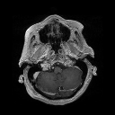


20
BICUBIC RESULTS
Downsampled
Super Resolution
Original

Slide 22
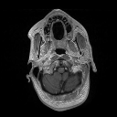


21
SR-RESNET RESULTS
Downsampled
Super Resolution
Original

Slide 23
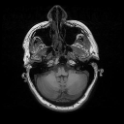
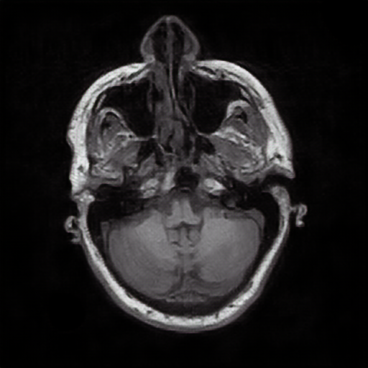

22
SRGAN RESULTS
Downsampled
Super Resolution
Original

Slide 24
23
DISCUSSION
ROADBLOCKS
Limited memory: resulting in reduced batch size and removal of 1024 dense layer.
Potential solution: better computing power.
Overfitting: resulting in worse performance on unseen data.
Potential solution: regularization, dropout layers.
WHY SR-RESNET OUTPERFORMED SRGAN
Limited batch size, removal of 1024 dense layer.
Only used 50 epochs.
Notes:
We ran into quite a few roadblocks throughout our experiments and model building.
The greatest of which was memory errors with the GPU we were using.
Because of this, we had to reduce our SRGAN batch size to 1, instead of the desired 32. Using a batch size of 32 simply far exceeded what our GPU could handle.
Additionally, we tried using a 1024 dense layer in our discriminator as proposed in the original SRGAN paper, but this had to be removed as well due to limited memory
Unfortunately, the only real way to avoid these obstacles would be to obtain resources with significantly better computing power.
As mentioned earlier, we also observed overfitting in our SRResNet. To fix this we could try to implement regularization or the including dropout layers.
Finally, we found it interesting that the SRResNet outperformed the SRGAN, it seems the addition of the adversarial network to the SRResNet did not improve it as expected.
We believe this may be attributed to the aforementioned limitations in the SRGAN, and due to the fact that we only ran 50 epochs.

Slide 25
24
CONCLUSION
Medical images can be unclear, and equipment is very expensive.
Our goal: to enhance the resolution of medical images using ML techniques.
Our results: Bicubic Interpolation << SRGAN < SR-ResNet.
Overall, impressed with results and proof of concept shows strong potential
Notes:
In conclusion,
blurry or unclear medical images can be difficult to examine, and high-quality imaging equipment is expensive. Hence our objective was to enhance the resolution of medical images using machine learning techniques and, in doing so, provide a possible method of reducing the difficulty and costs involved with medical imaging and analysis.
To achieve this, we produced several super resolution models. The first was a bicubic interpolation, which acted as a good baseline to our deep learning models.
The deep learning models we produced were the SRResNet and SRGAN,
Both deep learning methods significantly outperformed the bicubic method overall. However we were surprised to see that the SRGAN did not improve upon the SRResNet.
Overall, we were impressed with the results we obtained and believe this is a good proof of concept and a step towards providing improved medical image resolutions while reducing its cost.

Slide 26
THANK YOU

Slide 27
Works
Cited
[1] Primary and metastatic Brain Tumors. Shonka, N. A. et al. Cancer Network. November 1, 2015. https://www.cancernetwork.com/cancer-management/primary-and-metastatic-brain-tumors/page/0/1?fbclid=IwAR36gZydOT-rJXAZL-TavOdrhX4Gw1Sdfemmq8GAR9mRed3RtLjilx4fL0c
[2] Screen-Printed Flexible MRI receive coils. Corea, J. R. et al. Nature Communications. Article number: 10839. March 10, 2016. https://www.nature.com/articles/ncomms10839?fbclid=IwAR34j7nlq-MV_pvpPNxz9_lSzuhEqwccaw80y-KAUFS2V8VV2A0WZjkvNqs
[3] Cancer Stat Facts: Cancer of Any Site. National Cancer Institute. 2020. https://seer.cancer.gov/statfacts/html/all.html
[4] CPTAC-GBM. Cancer Imaging Dataset. February 14, 2020. https://wiki.cancerimagingarchive.net/display/Public/CPTAC-GBM
[5] Photo-Realistic Single Image Super-Resolution Using a Generative Adversarial Network. Ledig, Christian et al. July 2017. https://ieeexplore.ieee.org/document/80995

